Slide 1
Java team project Tank war(game)
design by: Anita Mirshahi & Qian gao

Slide 2
description of Game
This is a 2D game designed for all gender and age groups.
Anyone who opted in will benefit the enjoy of playing an action game as well as improving the attention, mood, cognitive, strengths.

Slide 3
Main features & functionalities

Slide 4
Challenges:
Movements of the tank
Shooting bullets
Collision detection
Multiple players & enemies

Slide 5
Solutions and technologies:
Graphics in AWT and Swing
KeyEvent
Multiple Threading

Slide 6
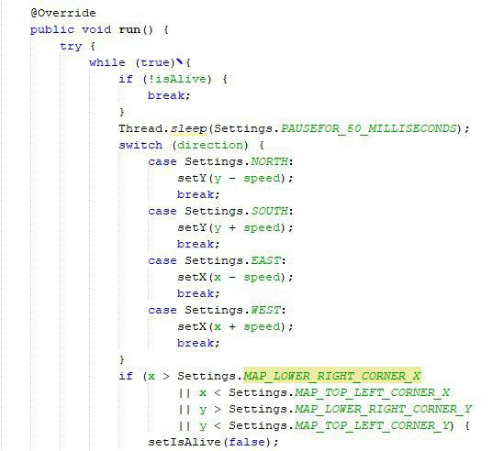

Slide 7
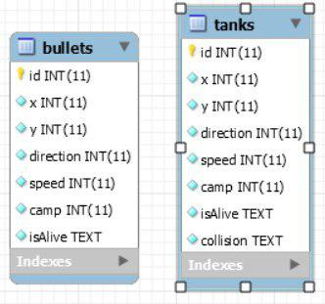
Database:

Slide 8
What we learned:
How to make 2D game
How to draw graphics
How to animate graphics
How to use keyboard to control game

Slide 9
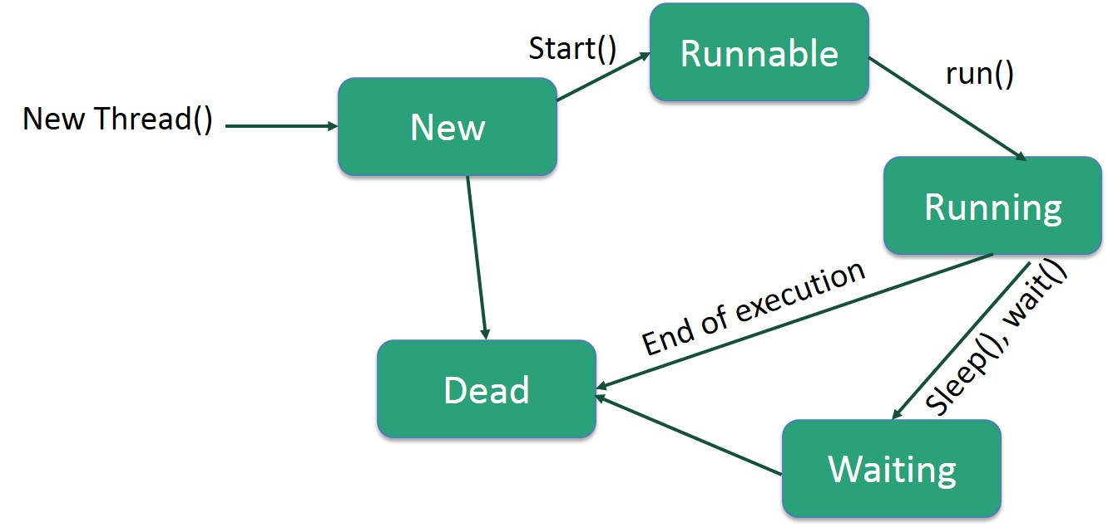
To learn:
Multithreading (Life Cycle of a Thread):

Slide 10
Future work:
Make levels for the game / Speed up
Live game / Play with two PCs
User can change settings
Create map

Slide 11
Summary:
Draw tanks
Move tanks
Collision
Shooting bullets
Explosion

